Slide 1



Lecture 4: Networking in Python
COMP280: Creative Computing
BSc(Hons) Computing for Games
BA(Hons) Game Development: Programming

Slide 2


Slide 3
Learning outcomes
Understand how the http server framework is implemented in Python
Develop suitable JSON packets to transmit data between client & server and server & client application
Create simple relational databases using sqlite
Program queries in sql to CRUD (create, retrieve, update and delete) data in a sqlite database

Slide 4
Worksheet and learning outcomes
https://learningspace.falmouth.ac.uk/course/view.php?id=4355
Use key full stack technologies to build applications
Python client
Unreal client
Python Server

Slide 6
Key Full stack Technologies
When we talk about full stack, we are talking about client-server architecture
And model, view, controller (MVC) architecture
MVC
Client(s)
View allows user to receive data and enter input
Server
Controller takes user input and sanitises it before updating model
Model stores all data
Client
Server
View
Controller
Model

Slide 7
Key Full stack Technologies
Server programming language & development frameworks (Controller)
Model language and tools
Data communications protocols between client and server
Client programming language & development frameworks (View)

Slide 8
Key Full stack Technologies
Server programming language & development frameworks
Python
Cross-platform language with lots of technical support
Wide range of tools and support libraries
Geared around rapid development
Strong support for different environments and locales
Simple threading architecture
Model language and tools
Data communications protocols between client and server
Client programming language & development frameworks

Slide 9
Key Full stack Technologies
Server programming language & development frameworks
Model language and tools
SQL
Industry standard database description and programming language
Sqlite
Cross-platform implementation of SQL reference
Data communications protocols between client and server
Client programming language & development frameworks

Slide 10
Key Full stack Technologies
Server programming language & development frameworks
Model language and tools
Data communications protocols between client and server
HTTP (Hypertext Transmission Protocol)
Industry-standard and mature communications protocol
Yes, it’s how all the browsers work
JSON (JavaScript Object Notation)
Industry-standard data transformation library
Well-suited to different platforms and languages
Client programming language & development frameworks

Slide 11
Key Full stack Technologies
Server programming language & development frameworks
Model language and tools
Data communications protocols between client and server
Client programming language & development frameworks
Python
See above
PyQt
UX/UI framework for Python to create attractive application UI
Unreal
Industry-leading game engine

Slide 12
Key Full stack Technologies
Client
Server
View
(Python/PyQt)
(Unreal)
Data Comms
(HTTP / JSON)
Controller
(Python)
Model
(SQL/Sqlite)

Slide 13
HTTP Server
HTTP is part of the WWW protocols
Hypertext Transfer Protocol
As a TP it defines how data is transferred between nodes on the internet
Internet –> inter-network, a network of nodes
Sits on TCP/IP

Slide 14
HTTP Server
HTTP is part of the WWW protocols
Defines client and server roles
Client will send messages (requests) to a server
OPTIONS, GET, HEAD, POST, PUT, DELETE, TRACE, CONNECT & PATCH
Generally we will use PUT & GET
PUT – send something to the server
GET – ask the server for some data
Server will respond to them

Slide 15
HTTP Server
HTTP is part of the WWW protocols
Like using a browser, this is client driven
Client sends a request, server responds
Client deals with response
Server can’t originate communications
Client-centric nature makes it useful for:
Requesting data from a server (persistent data, balance data etc)
Sending data to a server (high scores, analytics, persistent data)
Need to consider sockets for ‘proper’ network gaming (multiplayer FPS etc)

Slide 16
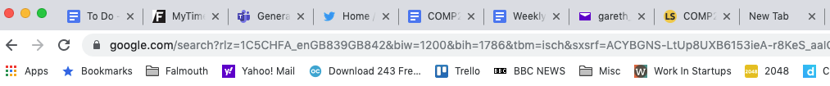
HTTP Server
HTTP is part of the WWW protocols
Generally a text (hypertext) protocol
You will often see HTTP command & data in web addresses
As we saw from cybersecurity, this can be extremely hackable
SQL injections!
HTTPS (s- secure) should prevent that

Slide 17
HTTP Server in Python
Python provides:
(Server-side) Abstract HTTPServer class
Make your own servers by overloading (re-writing) do_POST and do_GET methods
Create an instance of your server and serve_forever()
(Client-side) HTTPConnection class
Create an instance of an HTTPConnection()
Use
request(<command>, <data>) to send a request to the server
getresponse() to see if it worked
response.read() to read the response data

Slide 18
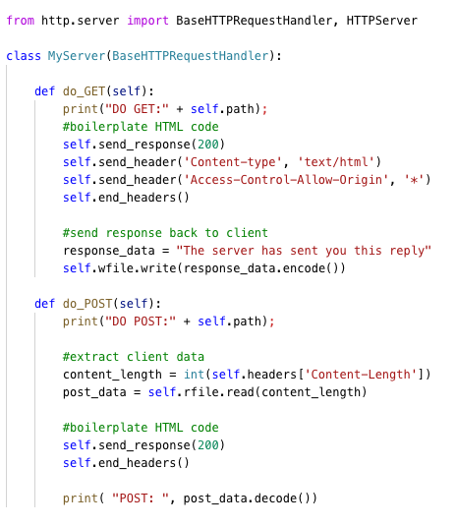
HTTP Server in Python
The server app: Boilerplater HTMPL Server class

Slide 19
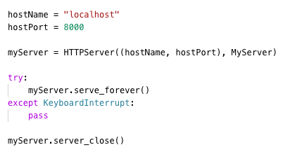
HTTP Server in Python
The server app: Instantiate & Launch
This will just sit waiting for clients to serve (as designed)

Slide 20
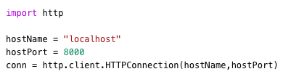
HTTP Server in Python
The client app: Create an HTTPConnection
NB
Make sure the hostname and port address match between client and server
OS can be sniffy on port IDs, check stackoverflow if your apps fail on instantiation

Slide 21
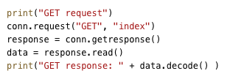
HTTP Server in Python
The client app : Boilerplater GET request
NB
Arguments and commands can embedded into the ‘index’ field of the conn.request (ripe for injections)
I would recommend JSON for this as it’s more flexible
Server will respond with bytes, so decode back to text

Slide 22
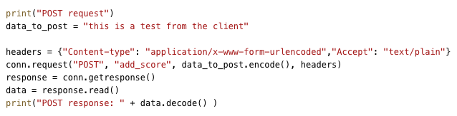
HTTP Server in Python
The client app : Boilerplater POST request
NB
POST will take arguments as part of command as data_to_post
Ideal for JSON encoding
Also support for data in the ‘add_score’ argument
See GET issues
However, need to pass in headers to define content type (generally just boilerplate)

Slide 23
JSON as a data protocol
JSON (JavaScript Object Notation)
Open-standard format for serialising and deserialising JavaScript object
Has become adopted as an open-format on the internet
Because it works with *objects* can serialise sequences and hierarchies of dissimilar objects
Works really well, until it doesn’t
Interesting edge cases to consider, especially between different languages (JS<->Python <->C# <->C++)

Slide 24
JSON as a data protocol
JSON (JavaScript Object Notation)
Python supports JSON as a core language feature
json class (import json)
json.dumps(object) -> convert object to json string
json.loads(string) -> convert string to object
https://www.w3schools.com/python/python_json.asp
Process
Object->json->string->bytes -> HTTP
HTTP->bytes->string->json->Object
https://www.w3schools.com/python/ref_string_encode.asp

Slide 25
JSON as a data protocol
JSON (JavaScript Object Notation)

Slide 26
PyQt as a view framework
Qt is an industry standard multi-platform UI framework
PyQt is the Python wrapper for it
Has a UI design tool (QtDesigner)
Projects can be loaded into a python app and Python’s reflection will sort out all the names
Import into your PyCharm projects through Package Manager

Slide 27
SQL / sqlite
Python supports sqlite as a core part of the language framework
import sqlite
Ideal for managing persistent data on server (or client)
SQL queries allow you to perform complex queries on your data
Also ideal for high score tables, simple analytics, game balance and so on.

Slide 28
SQL
We can think of a database as collection of data that is stored in tables
Ideally, each entry will have a unique identifier to make possible to identify that record and no other
CustomerID | Name | Age | Email
0 | Dave | 32 | dave@dave.com
1 | Barry | 94 | barry@barrysworld.org
2 | Joe | 22 | john@facebook.co.uk

Slide 29
SQL
We can think of a database as collection of data that is stored in tables
We can use unique references to link data between tables
Purchase records link to customers (last slide) and items (some other table)
Purchase ID | Customer ID | Delivered | Items
76 | 0 | Y | [754,281,998]
77 | 0 | N | [4]
78 | 1 | Y | [123,556,4]

Slide 30
SQL

Slide 31
Let’s make a kick-ass telephone book as a client-server application
Make a client-server application that will let you CRUD telephone numbers of your friends (whilst making sure you follow GDPR compliance)
Store the data in an SQL database on a server
Use a PyQt python client to access data
Use HTTP requests and JSON to manage data transmissions
It’s really small, but it will test all the aspects of full stack development
This will cover the Python & SQL criteria of the worksheet
Feel free to add more complexity if you fancy

Slide 32
Questions

